Slide 1
FACE DETECTION SUPREETA ANAND BYATNAL 1BM16IS090 TEJASWINI T N 1BM16IS091

Slide 2
OUTLINE
INTRODUCTION
PROBLEM STATEMENT
SOFTWARE USED
MODULE DESCRIPTION
SCREENSHOTS

Slide 3
INTRODUCTION

Slide 4
WHAT IT MEANS?
Face detection is a computer technology being used in a variety of applications that identifies human faces in digital images.
Face detection also refers to the psychological process by which humans locate and attend to faces in a visual scene.
Face-detection algorithms focus on the detection of frontal human faces.
Three-dimensional face detection technique uses 3D sensors to capture information about the shape of a face.
Face detection is also useful for selecting regions of interest in photo slideshows

Slide 5
PROBLEM STATEMENT

Slide 6
Humans can identify the face and facial features very quickly. But for the same task to be done by a computer, it is pretty hard.
Real- time face and facial features detection is the initial and the most important step for the development of any of the software in the high level applications.

Slide 7
SOFTWARE USED

Slide 8

OPEN CV
It is a library of programming
functions for real-time computer vision.
The face detection part of the project was made using an OpenCV library for Scala.

Slide 9

NETBEANS
Netbeans is an open-source integrated development environment (IDE) for developing with Java, PHP, C++, and other programming languages.
Netbeans runs on Microsoft Windows, macOS, Linux and Solaris.

Slide 10
HAAR-CASCADE
A Haar wavelet is a mathematical ﬁction that produces square-shaped waves with a beginning and an end and used to create box shaped patterns to recognize signals with sudden transformations.
To analyze an image using Haar cascades, a scale is selected smaller than the target image.

Slide 11
It is then placed on the image, and the average of the values of pixels in each section is taken.
If the difference between two values pass a given threshold , it is considered a match.
Face detection on human face is performed by matching a combination of different Haar-like-features.

Slide 12
MODULE DESCRIPTION

Slide 13
FACE DETECTION USING WEBCAM
By using webcam the image is detected, in this case only faces are recognizing and in eyes and nose.

Slide 14
FACE DETECTION IN AN IMAGE
We are inputting an image in the file in the program and output is also a image which will generate.
The output image has a face, eyes detected in the original image.

Slide 16
SCREENSHOTS

Slide 17
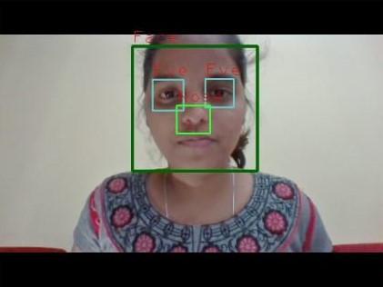
FACE DETECTION USING WEBCAM

Slide 18

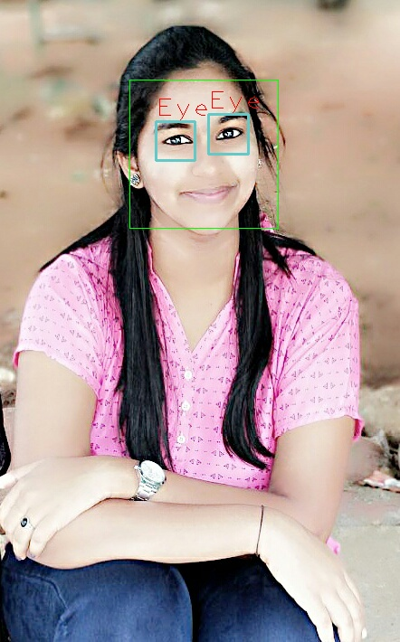
FACE DETECTION IN AN IMAGE
INPUT IMAGE OUTPUT IMAGE

Slide 19
THANK YOU!

